Slide 1
THE SCIENCE OF SIN AND SALVATION ROBERT MELASHENKO MD
Copyright Robert Melashenko 2013
All Rights Reserved

Slide 2
LECTURE TWELVE
OUR SALVATION: DO WE HAVE A PART TO PLAY?

Slide 3
REVIEW
Christ came to this earth to take on our burden of MGE’s; half of His genome came from Heaven, the other half from Mary. He lived a life where He did not waver from God’s law in the least particular, thus mastering the MGE driven inclinations. This mastery is made available to humanity through the Holy Spirit.
Many of the MGE’s afflicting the human genome are sequestered in the heterochromatin. The processes whereby the MGE’s are marked for sequester is, in most cases, dependent upon miRNA’s (small single strands of mRNA). The miRNA system is one of the most essential body communication modalities, and works both directly on the DNA, and on the mRNA. In this way, miRNA’s act as the ultimate “editors” of the genome.

Slide 4
REVIEW
The parable of grafting of a branch onto a grape vine in John 15 gives us an illustration of how Christ’s overcoming of the MGE’s can be applied to us. Science has clearly demonstrated that the grafted branch (humanity) can overcome MGE’s only by the miRNA’s that it receives from the stem of the vine which represents Christ.
Sequestering the MGE’s does not eliminate them from the cell. Nor does it replace the code that has been destroyed by the MGE infestation.
Christ became the “first fruit” to undergo removal of the MGE’s. This occurred on the cross and caused the death of the Son of God.
His resurrection and ascension up into heaven is the ultimate proof that the plan was successful in the complete removal of the MGE’s. The incredible part is not only that it could be done in the first place, but also that it was accomplished without changing who Christ was—for He is “the same yesterday, today and tomorrow”.

Slide 5
DEFINITIONS
SIN: The unauthorized changing of God’s information systems (or Law) through the addition or deletion of code in the human genome.
Whoever commits sin transgresses also the law: for sin is the transgression of the law. (1 John 3:4 AKJV)
INIQUITY: MGE’s
KINDGOM OF GOD:
And when he was demanded of the Pharisees, when the kingdom of God should come, he answered them and said, The kingdom of God comes not with observation: Neither shall they say, See here! or, see there! for, behold, the kingdom of God is within you.
(Luke 17:20-21 AKJV)

Slide 6
DEFINITIONS
GRACE: The process (which has multiple parts) by which God, via the Holy Spirit:
Removes or renders inactive the code in the genome generated through the Devil’s operating system via miRNA’s.
Writes new code to replace the original code destroyed by that system.
For what the law could not do, in that it was weak through the flesh, God sending his own Son in the likeness of sinful flesh, and for sin, condemned sin in the flesh: That the righteousness of the law might be fulfilled in us, who walk not after the flesh, but after the Spirit.
(Romans 8:3-4 AKJV)
For sin shall not have dominion over you: for you are not under the law, but under grace.
(Romans 6:14 AKJV)

Slide 7
DEFINITIONS
FAITH: The part we must play which allows God to use His grace to heal the damage done by the MGE’s.
For by grace are you saved through faith; and that not of yourselves: it is the gift of God: Not of works, lest any man should boast.
(Ephesians 2:8-9 AKJV)
And he that doubts is damned if he eat, because he eats not of faith: for whatever is not of faith is sin.
(Romans 14:23 AKJV)
But without faith it is impossible to please him: for he that comes to God must believe that he is, and that he is a rewarder of them that diligently seek him.
(Hebrews 11:6 AKJV)

Slide 8
So faith is very important because it is a prerequisite for God to work on our behalf. There are two aspects to faith:
Believing that God can do what He says (this is done not only on the molecular level which is not observable—but also on any level including the macro levels).
Act on the belief by cooperating with God in His act of grace (using only His circuitry).
He staggered not at the promise of God through unbelief; but was strong in faith, giving glory to God; And being fully persuaded that, what he had promised, he was able also to perform.
(Romans 4:20-21 AKJV)
Whom God has set forth to be a propitiation through faith in his blood, to declare his righteousness for the remission of sins that are past, through the forbearance of God;
(Romans 3:25 AKJV)

Slide 9
HOW DO WE OBTAIN FAITH?
Now faith is the substance of things hoped for, the evidence (conviction) of things not seen.
(Hebrews 11:1 AKJV)
And when he is come, he will reprove (convict) the world of sin, and of righteousness, and of judgment:
(John 16:8 AKJV)
And the apostles said to the Lord, Increase our faith.
(Luke 17:5 AKJV)

Slide 10
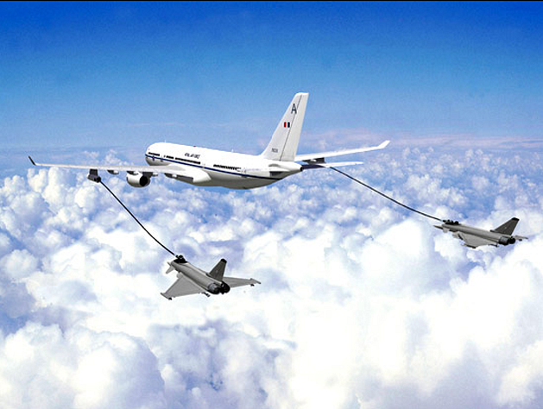

Slide 11
DEFINITIONS
SANCTIFICATION: The finished work of Grace.
But this shall be the covenant that I will make with the house of Israel; After those days, said the LORD, I will put my law in their inward parts, and write it in their hearts; and will be their God, and they shall be my people.
(Jeremiah 31:33 AKJV)
And they will see His face, and His name will be in their foreheads.
(Revelation 22:4 NKJV)

Slide 12
Sanctification makes us “fit” for Heaven. Although we often put “justification” before “sanctification”, sanctification is the road that one must travel to get to justification.
And such were some of you: but you are washed, but you are sanctified, but you are justified in the name of the Lord Jesus, and by the Spirit of our God.
(1 Corinthians 6:11 AKJV)
Therefore if any man be in Christ, he is a new creature: old things are passed away; behold, all things are become new.
(2 Corinthians 5:17 AKJV)

Slide 13
DEFINITIONS
JUSTIFICATION: To show one to be “right” or righteous ….provide evidence that one is “fit” for heaven. This term is often referred to as our “title” to heaven. It shows that we not only have a right to be there, but belong there.
Who was delivered for our offenses, and was raised again for our justification. (Romans 4:25 AKJV)
Whom God has set forth to be a propitiation through faith in his blood, to declare his righteousness for the remission of sins that are past, through the forbearance of God; To declare, I say, at this time his righteousness: that he might be just, and the justifier of him which believes in Jesus.
(Romans 3:25-26 AKJV)

Slide 14
BY WHAT EVIDENCE CAN GOD CLAIM THE RIGHT TO DECLARE HUMANS “RIGHTEOUS”?
And the LORD said to Satan, Have you considered my servant Job, that there is none like him in the earth, a perfect and an upright man, one that fears God, and eschews evil? and still he holds fast his integrity, although you moved me against him, to destroy him without cause. And Satan answered the LORD, and said, Skin for skin, yes, all that a man has will he give for his life. But put forth your hand now, and touch his bone and his flesh, and he will curse you to your face. And the LORD said to Satan, Behold, he is in your hand; but save his life.
(Job 2:3-6 AKJV)

Slide 15
GOD’S PART TO PLAY IN OUR SANTIFICATION
He provides the power.
And what is the exceeding greatness of his power to us-ward who believe, according to the working of his mighty power, Which he worked in Christ, when he raised him from the dead, and set him at his own right hand in the heavenly places,
(Ephesians 1:19-20 AKJV)

Slide 16
He provides the know-how.
But who may abide the day of his coming? and who shall stand when he appears? for he is like a refiner's fire, and like fullers' soap: And he shall sit as a refiner and purifier of silver: and he shall purify the sons of Levi, and purge them as gold and silver, that they may offer to the LORD an offering in righteousness. (Malachi 3:2-3 AKJV)
But this shall be the covenant that I will make with the house of Israel; After those days, said the LORD, I will put my law in their inward parts, and write it in their hearts; and will be their God, and they shall be my people. (Jeremiah 31:33 AKJV)

Slide 17
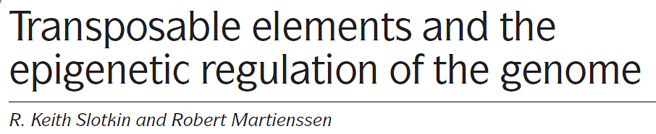
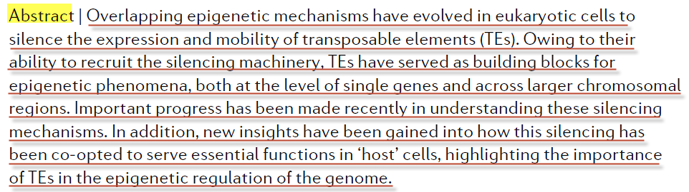
NATURE REVIEWS GENETICS. VOLUME 8. APRIL 2007

Slide 18
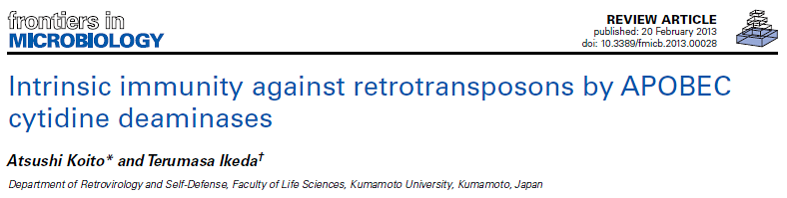
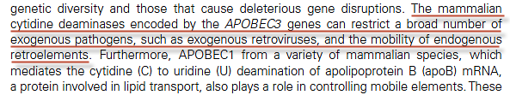

Slide 19
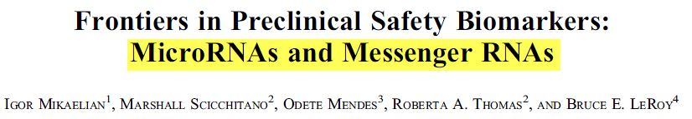

Toxicologic Pathology, 00: 1-14, 2012

Slide 20
Jesus answered them, Truly, truly, I say to you, Whoever commits sin is the servant (slave) of sin.
(John 8:34 AKJV)
Then said Jesus to those Jews which believed on him, If you continue in my word, then are you my disciples indeed; And you shall know the truth, and the truth shall make you free. (John 8:31-32 AKJV)
For this is my blood of the new testament, which is shed for many for the remission (release from bondage) of sins.
(Matthew 26:28 AKJV)

Slide 21
He promises not to overwhelm us while doing His work.
There has no temptation taken you but such as is common to man: but God is faithful, who will not suffer you to be tempted above that you are able; but will with the temptation also make a way to escape, that you may be able to bear it.
(1 Corinthians 10:13 AKJV)

Slide 22
He promises that he will not destroy who we are in the process.
Jesus Christ the same yesterday, and to day, and for ever.
(Hebrews 13:8 AKJV)

Slide 23
There are no cases which are beyond His ability to correct.
Why he is able also to save them to the uttermost (all complete, perfect) that come to God by him, seeing he ever lives to make intercession (to go to or meet a person, especially for the purpose of conversation, consultation, or supplication) for them. (Hebrews 7:25 AKJV)
But we see Jesus, who was made a little lower than the angels for the suffering of death, crowned with glory and honor; that he by the grace of God should taste death for every man.
(Hebrews 2:9 AKJV)

Slide 24
He will finish the job if you let Him.
Being confident of this very thing, that he which has begun a good work in you will perform it until the day of Jesus Christ:
(Philippians 1:6 AKJV)

Slide 25
The Holy Spirit does the work under Christ’s direct supervision.
However, when he, the Spirit of truth, is come, he will guide you into all truth: for he shall not speak of himself; but whatever he shall hear, that shall he speak: and he will show you things to come. He shall glorify me: for he shall receive of mine, and shall show it to you. (John 16:13-14 AKJV)
In whom you also are built together for an habitation of God through the Spirit.
(Ephesians 2:22 AKJV)

Slide 26
And grieve not the holy Spirit of God, whereby you are sealed (order to prove, confirm, or attest a thing) to the day of redemption. (Ephesians 4:30 AKJV)
Why I say to you, All manner of sin and blasphemy shall be forgiven to men: but the blasphemy against the Holy Ghost shall not be forgiven to men. And whoever speaks a word against the Son of man, it shall be forgiven him: but whoever speaks against the Holy Ghost, it shall not be forgiven him, neither in this world, neither in the world to come.
(Matthew 12:31-32 AKJV)

Slide 27
WHAT IS THE GOAL OF SANCTIFICATION?
In delivering us from sin, it is not enough that we shall be saved from the sins that we have actually committed; we must be saved from committing other sins. And that this may be so, there must be met and subdued this hereditary liability to sin; we must become possessed of power to keep us from sinning--a power to conquer this liability, this hereditary tendency that is in us to sin. (A. T. Jones - The Consecrated Way to Christian Perfection)
We know that whoever is born of God sins not; but he that is begotten of God keeps himself, and that wicked one touches (to fasten one’s self to, adhere to, cling to) him not.
(1 John 5:18 AKJV)

Slide 28
DO WE HAVE A PART TO PLAY IN OUR SANCTIFICATION?
GRACE vs. WORKS

Slide 29
ACTUALLY, BOTH WORKS AND GRACE ARE DIFFERENT FORMS OF LEGALISM!
Works
Grace
Pharisees
Legalism
Nicolaitans
Lawlessness

Slide 30
Works = Effort

Slide 31
GRACE
The doctrine of the Nicolaitans appears to have been a form of antinomianism, which makes the fatal mistake that man can freely partake in sin because the Law of God is no longer binding. It held the truth on the gratuitous reckoning of righteousness; but supposed that a mere intellectual "belief" in this truth had a saving power Today, the doctrine is now largely taught that the gospel of Christ has made God's law of no effect: that by "believing" we are released from the necessity of being doers of the Word. But this is the doctrine of the Nicolaitans, which Christ so unsparingly condemned in the book of Revelation. Theopedia

Slide 32
For sin shall not have dominion over you: for you are not under the law, but under grace.
(Romans 6:14 AKJV)
(What then? shall we sin, because we are not under the law, but under grace? God forbid.)
(Romans 6:15 AKJV)

Slide 33
What part of Grace do you not understand?
Then said Jesus to his disciples, If any man will come after me, let him deny himself, and take up his cross, and follow me.
(Matthew 16:24 AKJV)
So have you also them that hold the doctrine of the Nicolaitanes, which thing I hate.
(Revelation 2:15 AKJV)

Slide 34
WORKS
But will you know, O vain man, that faith without works is dead? Was not Abraham our father justified by works, when he had offered Isaac his son on the altar? See you how faith worked with his works, and by works was faith made perfect?
(James 2:20-22 AKJV)
Pure religion and undefiled before God and the Father is this, To visit the fatherless and widows in their affliction, and to keep himself unspotted from the world.
(James 1:27 AKJV)

Slide 35
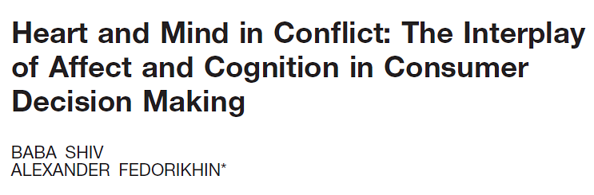
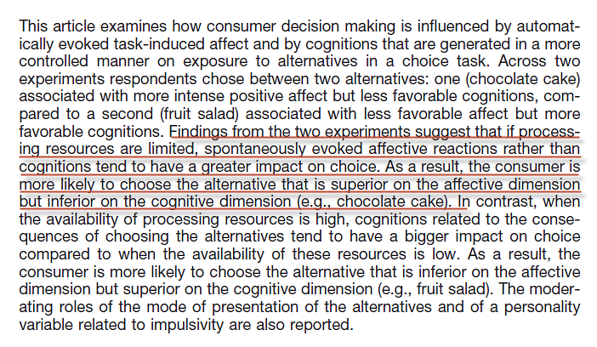
JOURNAL OF CONSUMER RESEARCH, Inc. Vol. 26 December 1999

Slide 36
For dieters, bandwidth scarcity has one particularly important consequence, illustrated in one study that gave people a choice between fruit salad and cake. Before choosing, half of the subjects had their bandwidth taxed: they were asked to remember a seven-digit number. The other half had a mentally less-demanding task: they were asked to remember a two-digit number. Those with less available bandwidth ate more cake: they were 50 percent more likely to choose cake than the others. There is a paradox here: diets create mental conditions that make it hard to diet.
New York Times September 21, 2013

Slide 37
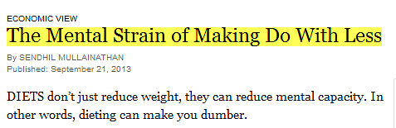

Slide 38
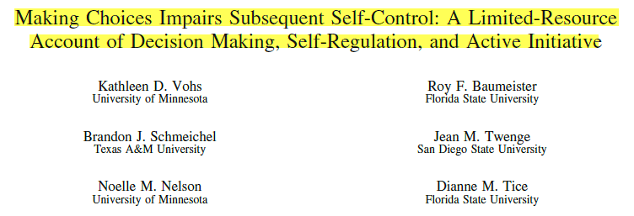
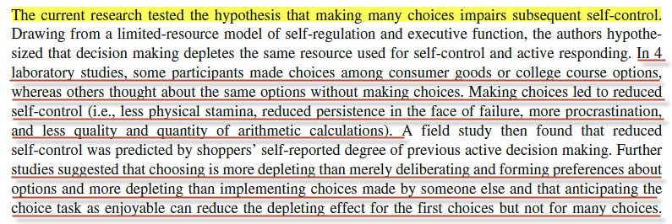
Journal of Personality and Social Psychology, 2008, Vol. 94, No. 5

Slide 39
BREAKING GOD’S LAW HAS NOTHING TO DO WITH LEGAL PRONOUNCEMNTS—IT HAS EVERYTHING TO DO WITH REAPING CONSEQUENCES!

Slide 40
Be not deceived; God is not mocked: for whatever a man sows, that shall he also reap. (Galatians 6:7 AKJV)
For sin pays its wage---death; but God's free gift is eternal life in union with Christ Jesus our Lord. (Romans 6:23 GNB)
I will give you the keys of the kingdom of heaven; whatever you bind on earth will be bound in heaven, and whatever you loose on earth will be loosed in heaven. (Matthew 16:19 NIV)

Slide 41
And if any man hear my words, and believe not, I judge him not: for I came not to judge the world, but to save the world. He that rejects me, and receives not my words, has one that judges him: the word that I have spoken, the same shall judge him in the last day.
(John 12:47-48 AKJV)

Slide 42
And this is the condemnation, that light is come into the world, and men loved darkness rather than light, because their deeds were evil. For every one that does evil hates the light, neither comes to the light, lest his deeds should be reproved. But he that does truth comes to the light, that his deeds may be made manifest, that they are worked in God.
(John 3:19-21 AKJV)
Whoever is evil must go on doing evil, and whoever is filthy must go on being filthy; whoever is good must go on doing good, and whoever is holy must go on being holy.“ (Revelation 22:11 GNB)

Slide 43
ARE WE EXPECTED TO DO SOMETHING IN OUR SALVATION?
Remain under
Keep the Sabbath
Tell others

Slide 44
Remain Under
Why, my beloved, as you have always obeyed, not as in my presence only, but now much more in my absence, work out your own salvation with fear and trembling. For it is God which works in you both to will and to do of his good pleasure. (Philippians 2:12-13 AKJV)
Whereunto I also labor, striving according to his working, which works in me mightily.
(Colossians 1:29 AKJV)
To get this done I toil and struggle, using the mighty strength which Christ supplies and which is at work in me.
(Colossians 1:29 GNB)

Slide 45
WHAT DO WE “TOIL AND STRUGGLE” WITH -- IF NOT GRACE OR WORKS?
James, a servant of God and of the Lord Jesus Christ, to the twelve tribes which are scattered abroad, greeting. My brothers, count it all joy when you fall into divers temptations; Knowing this, that the trying of your faith works patience. But let patience have her perfect work, that you may be perfect(brought to its end, finished) and entire, wanting nothing.
(James 1:1-4 AKJV)
For whom the Lord loves he chastens, and whips every son whom he receives. If you endure chastening, God deals with you as with sons; for what son is he whom the father chastens not? But if you be without chastisement, whereof all are partakers, then are you bastards, and not sons.
(Hebrews 12:6-8 AKJV)

Slide 46


Slide 47
But rejoice, inasmuch as ye are partakers of Christ's sufferings; that, when his glory shall be revealed, ye may be glad also with exceeding joy.
(1Peter 4:13 KJV)

Slide 48
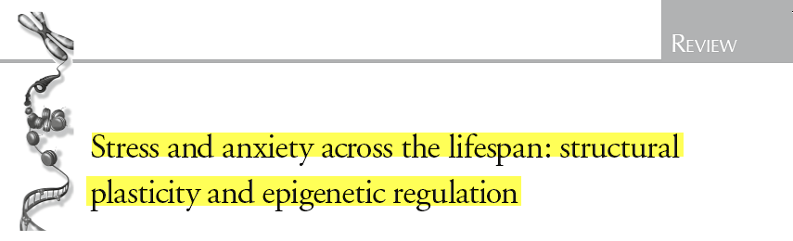
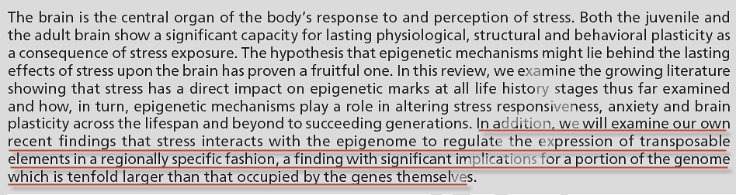
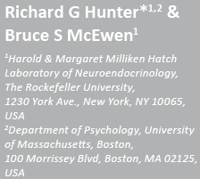

Slide 49
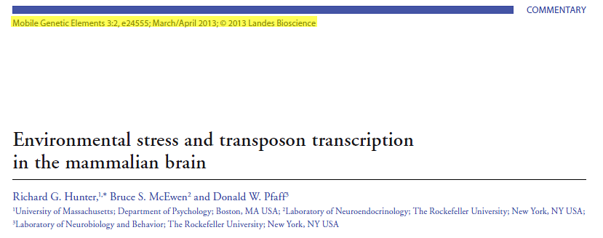
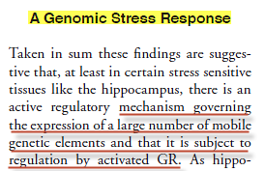

Slide 50
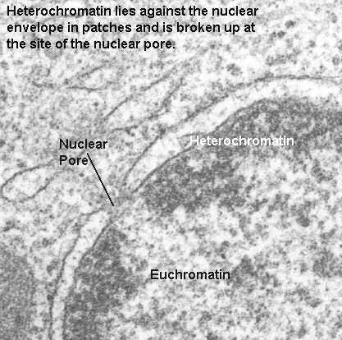
Heterochromatin

Slide 51
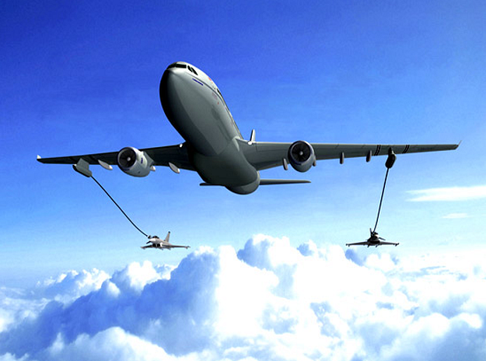

Slide 52
Then said Jesus to his disciples, If any man will come after me, let him deny himself, and take up his cross, and follow me. (Matthew 16:24 AKJV)
Wherein you greatly rejoice, though now for a season, if need be, you are in heaviness through manifold temptations: That the trial of your faith, being much more precious than of gold that perishes, though it be tried with fire, might be found to praise and honor and glory at the appearing of Jesus Christ:
(1 Peter 1:6-7 AKJV)

Slide 53
SALVATION IS “FREE….BUT IT WILL COST YOU EVERYTHING!”
Enter you in at the strait gate: for wide is the gate, and broad is the way, that leads to destruction, and many there be which go in there at: Because strait is the gate, and narrow is the way, which leads to life, and few there be that find it.
(Matthew 7:13-14 AKJV)
Again, the kingdom of heaven is like to a merchant man, seeking goodly pearls: Who, when he had found one pearl of great price, went and sold all that he had, and bought it.
(Matthew 13:45-46 AKJV)

Slide 54
But he that shall endure (to remain, i.e. abide, not recede or flee) to the end, the same shall be saved. (Matthew 24:13 AKJV)
Now when Jesus was risen early the first day of the week, he appeared first to Mary Magdalene, out of whom he had cast seven devils.
(Mark 16:9 AKJV)
Being confident of this very thing, that he which has begun a good work in you will perform it until the day of Jesus Christ:
(Philippians 1:6 AKJV)

Slide 55
Why is the Sabbath a special day ?
To you first God, having raised up his Son Jesus, sent him to bless you, in turning away every one of you from his iniquities.
(Acts 3:26 AKJV)
And God blessed the seventh day, and sanctified it: because that in it he had rested from all his work which God created and made. (Gen 2:3 KJV)
Moreover also I gave them my Sabbaths, to be a sign between me and them, that they might know that I am the LORD that sanctify them. (Ezekiel 20:12 AKJV)

Slide 56
If you turn away your foot from the Sabbath, from doing your pleasure on my holy day; and call the Sabbath a delight, the holy of the LORD, honorable; and shall honor him, not doing your own ways, nor finding your own pleasure, nor speaking your own words: Then shall you delight yourself in the LORD; and I will cause you to ride on the high places of the earth, and feed you with the heritage (possession, property, inheritance, heritage) of Jacob your father: for the mouth of the LORD has spoken it.
(Isaiah 58:13-14 AKJV)

Slide 57
For dieters, bandwidth scarcity has one particularly important consequence, illustrated in one study that gave people a choice between fruit salad and cake. Before choosing, half of the subjects had their bandwidth taxed: they were asked to remember a seven-digit number. The other half had a mentally less-demanding task: they were asked to remember a two-digit number. Those with less available bandwidth ate more cake: they were 50 percent more likely to choose cake than the others. There is a paradox here: diets create mental conditions that make it hard to diet.
New York Times September 21, 2013

Slide 58
So then faith comes by hearing, and hearing by the word of God. (Romans 10:17 AKJV)
Husbands, love your wives, even as Christ also loved the church, and gave himself for it; That he might sanctify and cleanse it with the washing of water by the word, (Ephesians 5:25-26 AKJV)
Being born again, not of corruptible seed, but of incorruptible, by the word of God, which lives and stays for ever. (1 Peter 1:23 AKJV)

Slide 59
Tell Others
Go you therefore, and teach all nations, baptizing them in the name of the Father, and of the Son, and of the Holy Ghost: Teaching them to observe all things whatever I have commanded you: and, see, I am with you always, even to the end of the world. Amen.
(Matthew 28:19-20 AKJV)

Slide 60
Only the Creator of the information system can repair and rewrite the code.
In the beginning was the Word, and the Word was with God, and the Word was God. The same was in the beginning with God. All things were made by him; and without him was not any thing made that was made.
(John 1:1-3 AKJV)
Neither is there salvation in any other: for there is none other name under heaven given among men, whereby we must be saved.
(Acts 4:12 AKJV)

Slide 61
When does this “sanctification” occur—now, or in the future?
Teaching us that, denying ungodliness and worldly lusts, we should live soberly, righteously, and godly, in this present world; (Titus 2:12 AKJV)
That you may be blameless and harmless, the sons of God, without rebuke, in the middle of a crooked and perverse nation, among whom you shine as lights in the world;
(Philippians 2:15 AKJV)
Having a form of godliness, but denying the power thereof: from such turn away.
(2 Timothy 3:5 AKJV)

Slide 62
WHAT HAPPENS WHEN CHRIST REMAKES US?
Whoever is born of God does not commit sin; for his seed remains in him: and he cannot sin, because he is born of God.
(1 John 3:9 AKJV)
Therefore if any man be in Christ, he is a new creature: old things are passed away; behold, all things are become new.
(2 Corinthians 5:17 AKJV)
This does not mean that we will never make a mistake--because we still have defective hardware and software. What it does mean is that we will no longer listen (much less give thought to) the Evil One when he comes to seduce us. This will be the case for the 144,000 spoken of in Revelation 14.

Slide 63
We will become “one”.
My little children, of whom I travail in birth again until Christ be formed in you,
(Galatians 4:19 AKJV)
By this shall all men know that you are my disciples, if you have love one to another.
(John 13:35 AKJV)
That they all may be one; as you, Father, are in me, and I in you, that they also may be one in us: that the world may believe that you have sent me.
(John 17:21 AKJV)

Slide 64
With rewritten code, Christ’s followers will think and behave like their Author—that is why they will naturally congregate together and form His church.

